Slide 1


What is Shaping Data?

Slide 2
How do you know if data has realistic values?
How do you know if data is the correct shape for mathematical operations?
Shaping data!

Slide 3
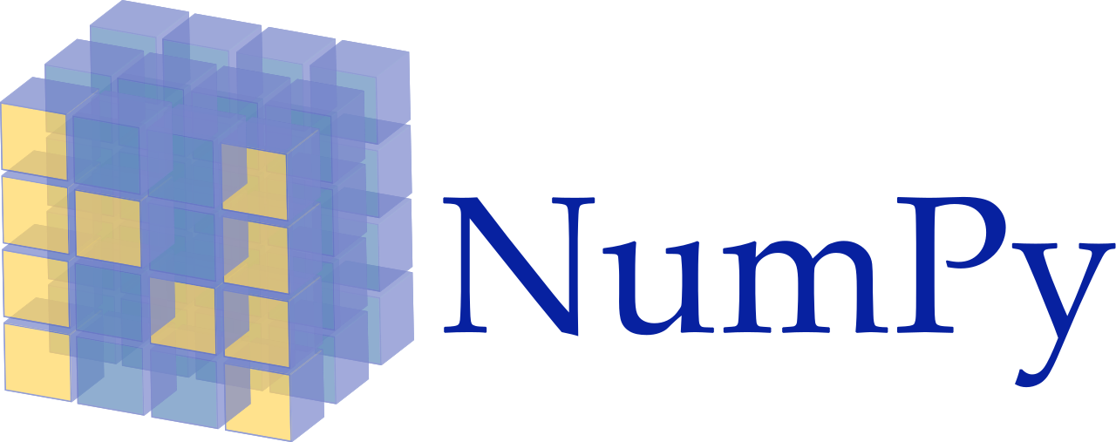
How can you reshape data?
Python’s NumPy package

Slide 4
Input data, layers of neurons, and output data come in arrays of various shapes

Slide 5
input
output
Neural Network Layer

Slide 6
NumPy lets you reshape arrays

Slide 7
input
output
Neural Network Layer

Slide 8
NumPy’s ndarray type is a wrapped around Python’s list type

Slide 9
NumPy’s type is a decorator
Provides extra methods for working with arrays

Slide 10
Shapes of arrays must be manipulated to work with some mathematical operations
Some dimensions of matrices must match

Slide 11
What is Shaping Data? ✓
Let’s begin...

